Slide 1
Electric Vehicle (EV) Sales Analysis – India
Key Insights by Manufacturers & State

Slide 2
DASHBOARD HIGHLIGHTS
Top & Bottom EV Makers (2-wheelers) in FY 2023 & 2024
State-wise EV Penetration: Identifies high and low adoption regions
Sales Decline Analysis: States with negative EV growth from 2022–2024
Quarterly Trends: Performance of top 4-wheeler EV makers
Comparative Analysis: EV sales & penetration in Delhi vs Karnataka
CAGR Analysis: Growth rates by maker and by state (2022–2024)
Seasonality: Peak and low seasons for EV sales
2030 Forecast: Projected EV sales using CAGR
Revenue Growth Estimates: 2W and 4W EV segments (2022–2024)

Slide 3
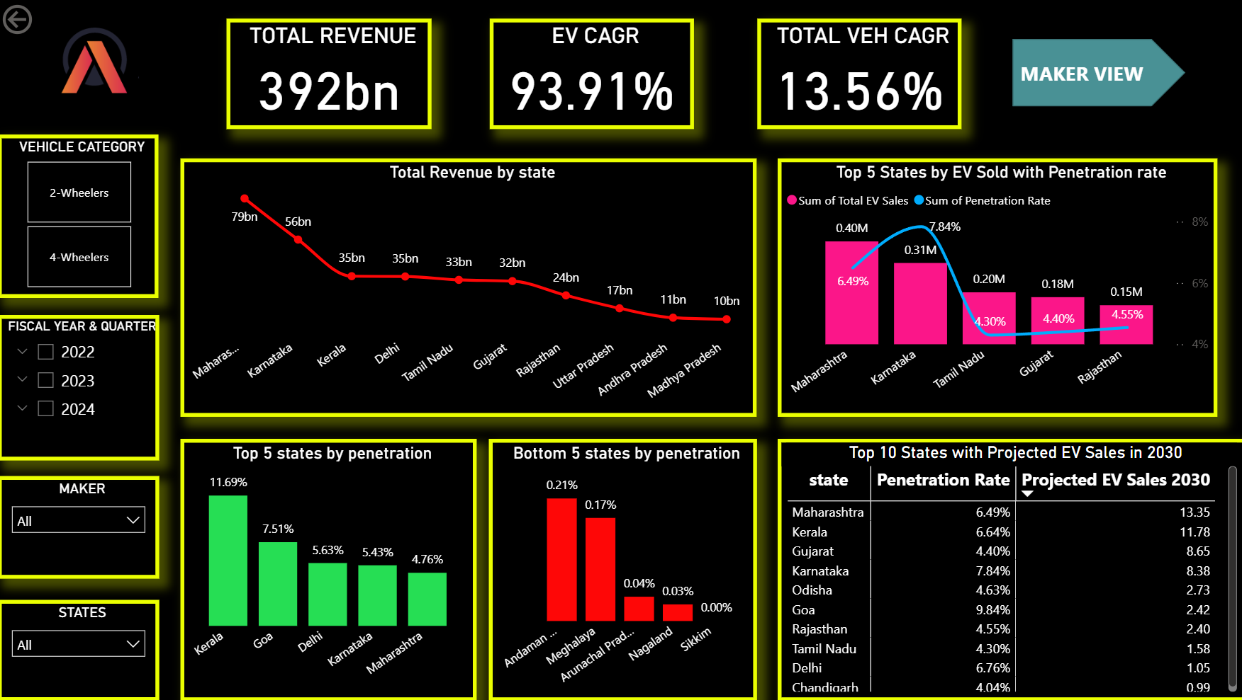
STATES VIEW

Slide 4
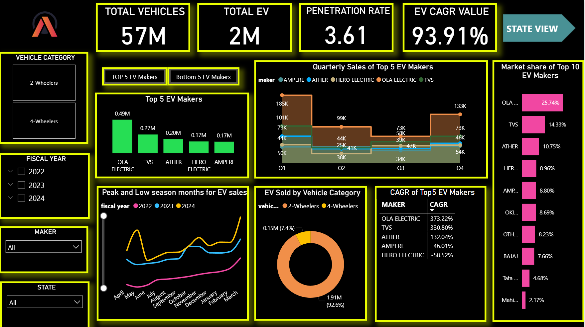
MAKER’S VIEW

Slide 5
Overview of EV Market in India
India’s EV market is growing rapidly due to:
Government subsidies (FAME II)
Better charging infrastructure
Increased adoption of 2W EVs
EV penetration highest in 2-wheelers, followed by 4-wheelers
Sales growth driven mainly by urban and semi-urban markets

Slide 6
EV Sales by Manufacturers (Top Performers)
Top EV Makers dominate majority of sales:
Example: Tata Motors leads in 4W EV sales with models like
Nexon EV, Tiago EV
TVS, Ola, Ather lead in 2W EV segment
The market shows high concentration, with top 3 manufacturers
contributing majority of total sales
New entrants are expanding, but volume is still low

Slide 7
EV Sales by States
Top Performing States: (Based on typical trends)
  Maharashtra, Karnataka, Tamil Nadu, Delhi, Uttar Pradesh
Factors driving sales:
  Higher urban population
  Better charging infrastructure
  State-level EV incentives and road tax exemptions
Southern states show strong adoption in both 2W and 4W segments

Slide 8
Growth Trends & Seasonality
Consistent month-on-month increase in EV sales due to :
Festivals (Oct–Dec) usually show spike in sales
2W EVs show more seasonal variation than 4W Evs
Slowdowns often due to:
Battery-related concerns
Changes in subsidy policies

Slide 9
Key Insights & Recommendations
Insights
EV market is growing, dominated by a few manufacturers
Strong regional variation, with South & West India leading
2W EV segment contributes the largest share
Recommendations
Expand charging infra in Tier-2/3 cities
Target marketing in high-growth states
Increase financing options for EV buyers
Promote entry-level EV models to improve penetration

